Slide 1

JAYPEE UNIVERSITY OF INFORMATION TECHNOLOGY, WAKNAGHAT
Developing Hand gesture detection system to recognize expressions
Minor Project - II(18B19CI691)
Amit Sharma
201236
Raunak Kumar Thakur
201237
Mr. Nishant Sharma
Assistant Professor(Grade-II)

Slide 2
Introduction
The purpose of this project is to develop a hand gesture detection system that can recognize expressions accurately.
The importance of nonverbal communication cannot be overstated. Hand gestures play a significant role in expressing emotions and communicating nonverbally. However, traditional methods of expression recognition have limitations and are not always accurate. We aim to solve this problem by developing a more accurate and reliable method of expression recognition.
In this project, we are using an image segmentation model that segments the foreground and background. This can then be passed to the CNN model or any other similar model for classification.
The model focuses on:
* Extracting the hand from the background.
* Building a Gesture Recognition model using a custom dataset.
* Predicting sign language in real-time using video sequences.

Slide 3
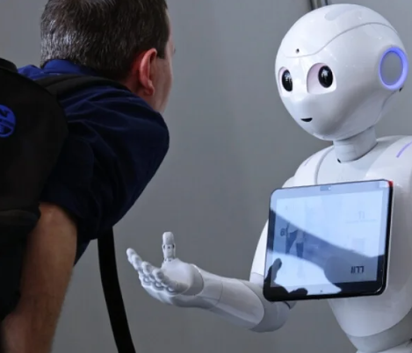
Problem Statement
Challenges that our project is aiming to address

Slide 4

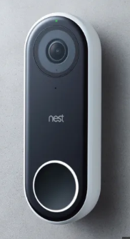
Problem statement
Language recognition
Speech impairment affects verbal communication and hearing. It can lead to challenges in social interactions and a lower quality of life. People with speech impairment may use sign language to communicate.
Smart home devices
Smart home devices do not consider the daily routines of senior citizens when designing their operation modes. As a result, seniors often have trouble using these devices effectively, leading to frustration and loss of independence.
Human-robot interaction
Human-robot interaction is common but current technology may lack understanding of human behavior and emotions, leading to ineffective communication and reduced efficiency.

Slide 5
Project Objectives
Our project aims to achieve the following objectives:
To develop a hand gesture detection system that can recognize expressions accurately.
To explore different algorithms and techniques for hand gesture detection and expression recognition.
To test the developed system on different datasets and compare the results with existing methods.
We aim to achieve these objectives by using Data Science and Machine Learning models developed in Python.

Slide 6
Literature Review
S. No. | Title | Author | Problem | Objective | Algorithm | Features/Parameters | Characteristics | Accuracy
1 | Real-time Hand Gesture Detection and Recognition using Support Vector Machine | S. A. Bhosale and S. S. Sarnobat | Detection of Hand Gestures in Real-Time | To develop an efficient and accurate hand gesture recognition system | Support Vector Machine (SVM) | Histogram of Oriented Gradients (HOG) | Real-time, robust to lighting changes and hand size variations | 96%
2 | Hand Gesture Recognition for Sign Language using Convolutional Neural Network | M. A. Khan and T. Zahid | Hand Gesture Recognition for Sign Language | To recognize sign language gestures accurately | Convolutional Neural Network (CNN) | Depth and RGB images | Accuracy, robustness to occlusions | 98.80%
3 | Hand Gesture Recognition for Human-Robot Interaction using Hidden Markov Model | H. Li and H. Liang | Hand Gesture Recognition for Human-Robot Interaction | To enable human-robot interaction through hand gestures | Hidden Markov Model (HMM) | Motion history images and hand position | Real-time, high recognition rate | 94.50%
4 | Hand Gesture Recognition for Smart Homes using Decision Tree Algorithm | A. S. Pawar and S. V. Gandhi | Hand Gesture Recognition for Smart Homes | To enable gesture-based control in smart homes | Decision Tree | Finger count and hand shape | Low computational complexity, ease of use | 85.60%

Slide 7
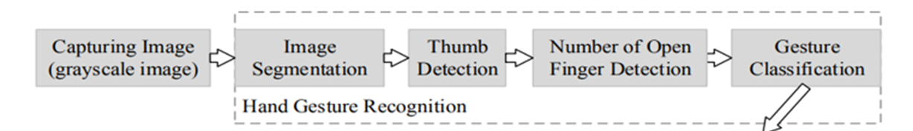
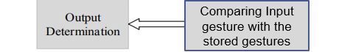
System Design

Slide 8
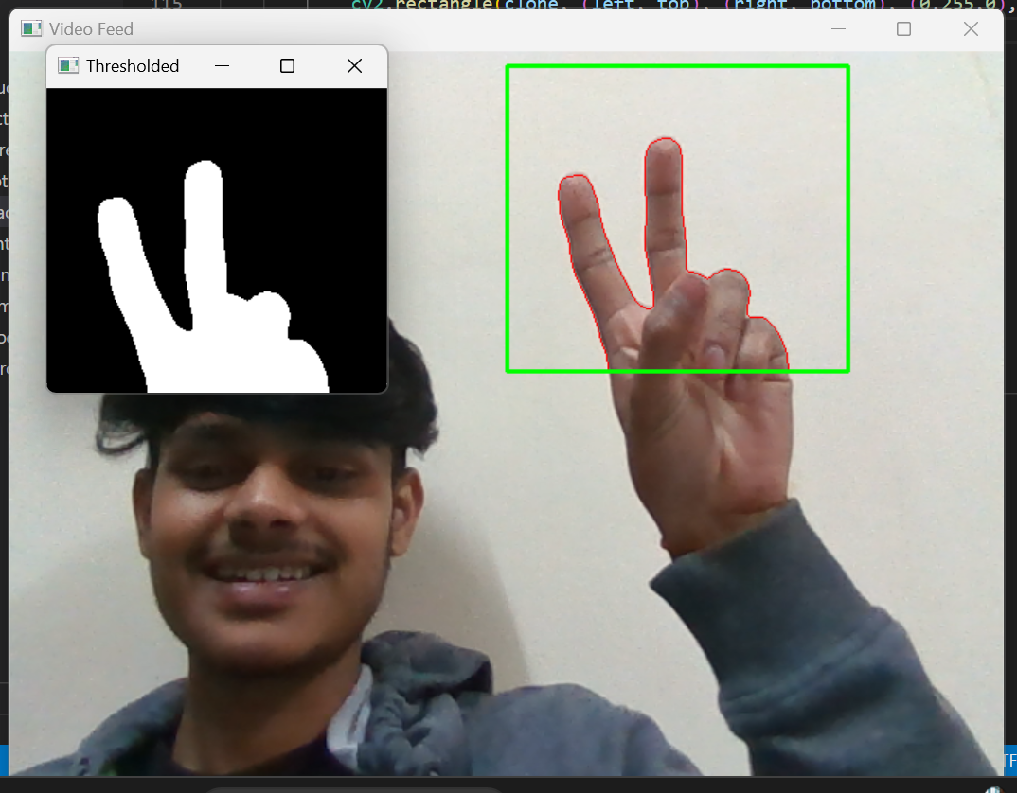
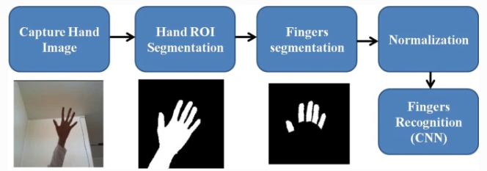
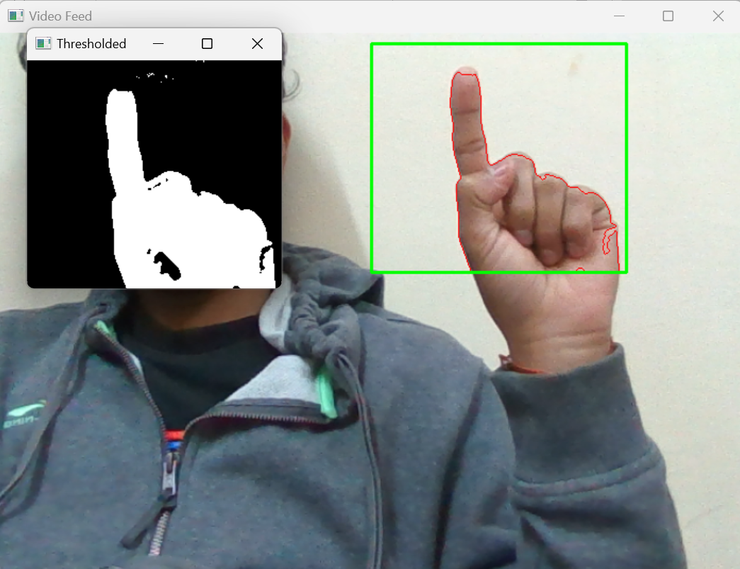
System Design

Slide 9



Tools/ Platforms/ Technology/ Languages Used
We are creating our own dataset parallelly
Tools & Platforms used:
* VScode for setting up environment
* OpenCV library
* imutils library
Language Used: Python

Slide 10
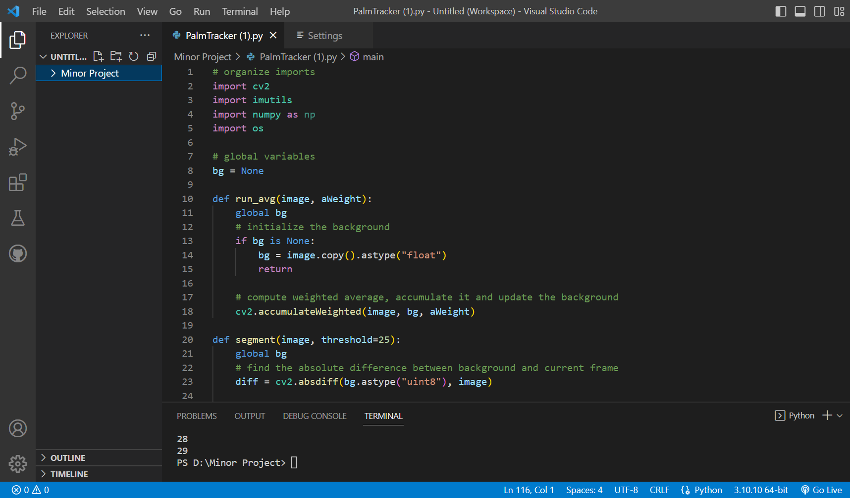
CODE implementation TILL now…….

Slide 11
Future work
• We are exploring different algorithms and techniques for hand gesture detection and expression recognition and are designing a system that incorporates state-of-the-art AI and ML models.
• The system's effectiveness will be evaluated by testing it on different datasets which we are currently preparing parallelly and will be comparing the results with existing methods.

Slide 12
references
[1] Das, A., Gawde, S., Suratwala, K., Kalbande, D. “Sign Language Recognition Using Deep Learning on Custom Processed Static Gesture Images”. 2018 International Conference on Smart City and Emerging Technology (ICSCET), (2018).
[2] “Smartphone Authentication with Hand Gesture Recognition (HGR) Using LiDAR” . Abdelghafar R. Elshenaway(2021)
[3] Development of Hand Gesture Based Electronic Key Using Microsoft Kinect. Arief Ramadhani, Achmad Rizal and Erwin Susanto,School of Electrical Engineering, Telkom University, 40257 Bandung, Indonesia(2018)
[4] Hand Gesture Recognition by a MMG-Based Wearable Device, Yu-Ting Lin , Zhao-Wei Qiu (2020)
[5] Lewis, M. Paul; Simons, Gary F.; Fennig, Charles D., eds. (2013), "Deaf sign language", Ethnologue: Languages of the World (17th ed.), SIL International, retrieved 2013-12-03.
[6] Zhang, Y., Hu, Q., Meng, Z., Ralescu, A.: Fuzzy dynamic timetable scheduling for public transit. Fuzzy Sets Syst. (2019)

Slide 13
THANK YOU
Amit Sharma
201236
Raunak Kumar Thakur
201237

